Slide 1
TAK Server Management

Slide 2
TAK Server – Logging
There are many log files that are available for monitoring during execution. They are located within the /opt/tak/logs directory:
To view a specific log, you can run the following:
tail –f /opt/tak/logs/<log file>
Example: tail –f /opt/tak/logs/takserver-messaging.log
Types of log files:
takserver-messaging.log – Execution-level information about the messaging process, including client connection events, error messages and warnings.
takserver-api.log – Execution-level information about the API (Application Programming Interface) process, including error messages and warnings.
takserver-messaging-console.log – Java Virtual Machine (JVM) informational messages and errors, for the messaging process.
takserver-api-console.log – Java Virtual Machine (JVM) informational messages and errors, for the API process.

Slide 3
TAK Server – Database Manipulation
Purging the database will reset the entire database to a clean slate.
To purge the TAK Server database run the following:
sudo java -jar /opt/tak/db-utils/SchemaManager.jar purge && sudo java -jar /opt/tak/db-utils/SchemaManager.jar upgrade
To start the database:
sudo /opt/tak/db-utils/SchemaManager.jar upgrade
You can run sudo /opt/tak/db-utils/SchemaManager.jar to see the different commands it can do.
To manually archive the database:
sudo /opt/tak/db-utils/archive-data.sh
Note: wherever you run this is where the archive file will be stored.
To manually restore a database:
sudo /opt/tak/db-utils/restore-data.sh <file>

Slide 4
TAK Server – Mission Packages and Files Expiration
From the Mission Manager you are able to manipulate the files as needed.
To set an expiration date for a file go to the mission manager (Data → Mission manager):
For mission packages and other files, you can set an expiration date by selecting the item then selecting “Edit”.
Inside the editing panel, under the “Expiration” tab, you are able to set the date and time for the file/data package to expire at.
If you wish to delete the entry immediately you can select the item, then select “Delete” option instead of editing.

Slide 5
TAK Server – Data Retention Tool
Data Retention Policy:
The Data Retention Tool (Administrative → Data Retention) allows the user to specify the retention policy for the following data types:
CoT (no-chat)
GeoChat (chat CoT messages)
Missions (including mission structure, tracks and files)
Mission Packages
Files (all enterprise sync data that is not mission data)
Users have the option to defines a TTL (time-to-live) interval on data, where the data will expire after it exceeds the TTL.
The deletion of the data is handled by the Retention Service that executes periodically.
It can be set to a scheduled frequency but is set to never by default.

Slide 6
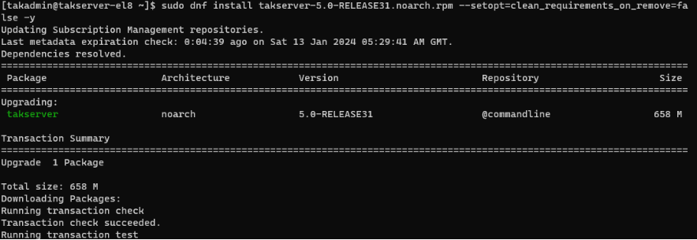
Updating the TAK Server
Update the TAK Server:
Download the latest version of TAK Server to your local machine.
You can get the latest version from the following link: https://tak.gov/products/tak-server
Transfer the file to your TAK Server machine:
Navigate to where the TAK Server install is on your local machine.
Open a terminal at that location.
Transfer the file:
scp <TAKServer File> <username>@<IP address>:~/
Example: scp takserver-5.2-RELEASE16.noarch.rpm <username>@<IP>:~/
On your TAK Server
Update the server
sudo dnf install takserver-5.2-RELEASE16.noarch.rpm --setopt=clean_requirements_on_remove=false -y
Notes:
# To update the TAK Server when a new release is published, start by transferring the update to the TAK Server and then execute the installation command.

Slide 7
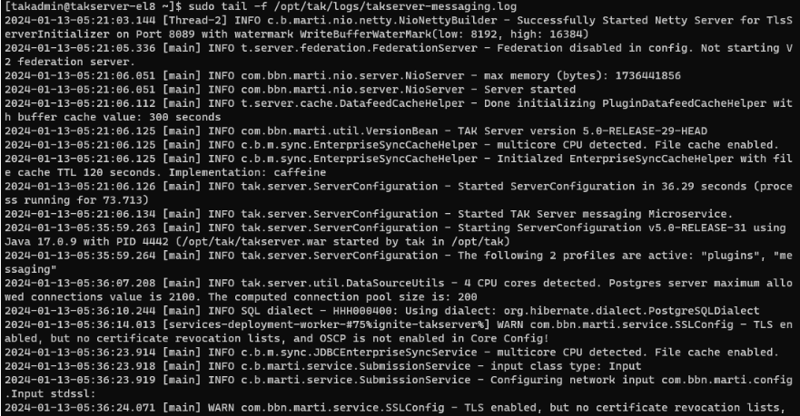
Updating the TAK Server
Reload the system manager:
sudo systemctl daemon-reload
Restart the TAK Server:
sudo systemctl restart takserver
Monitor the logs for errors:
sudo tail -f /opt/tak/logs/takserver-messaging.log
Notes:
# After the update is complete we need to reload the service manager followed by restarting the TAK Server.

